Slide 1
PREDICTING CUSTOMER CHURN IN TELECOM INDUSTRY
Name: Giridaran R A
Date: 21-08-2024

Slide 2
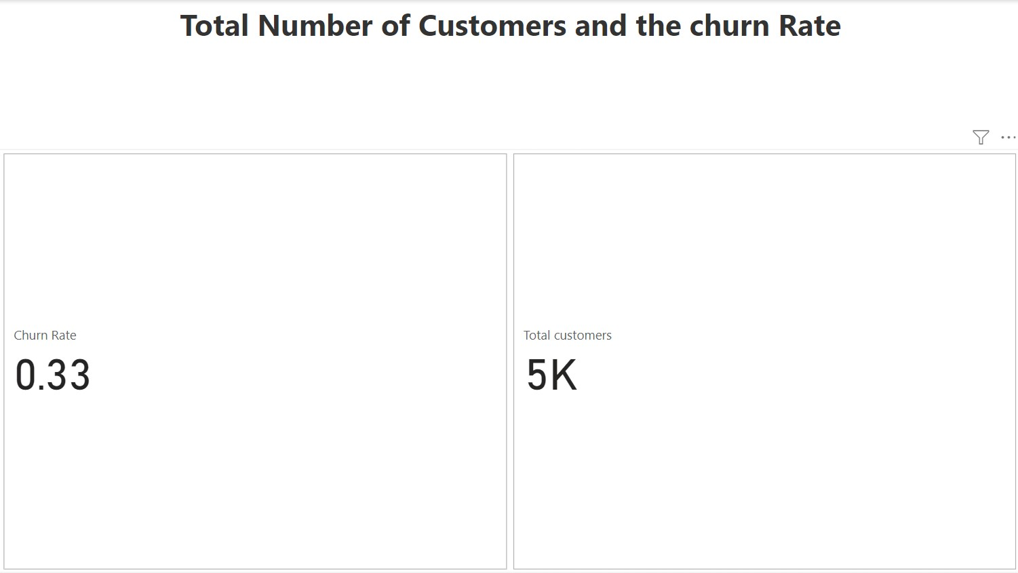
From this we can able to understand the total number of Customers in the telecom industry as per data
In this chart, here we find out the total number churned customers and the churn rate

Slide 3
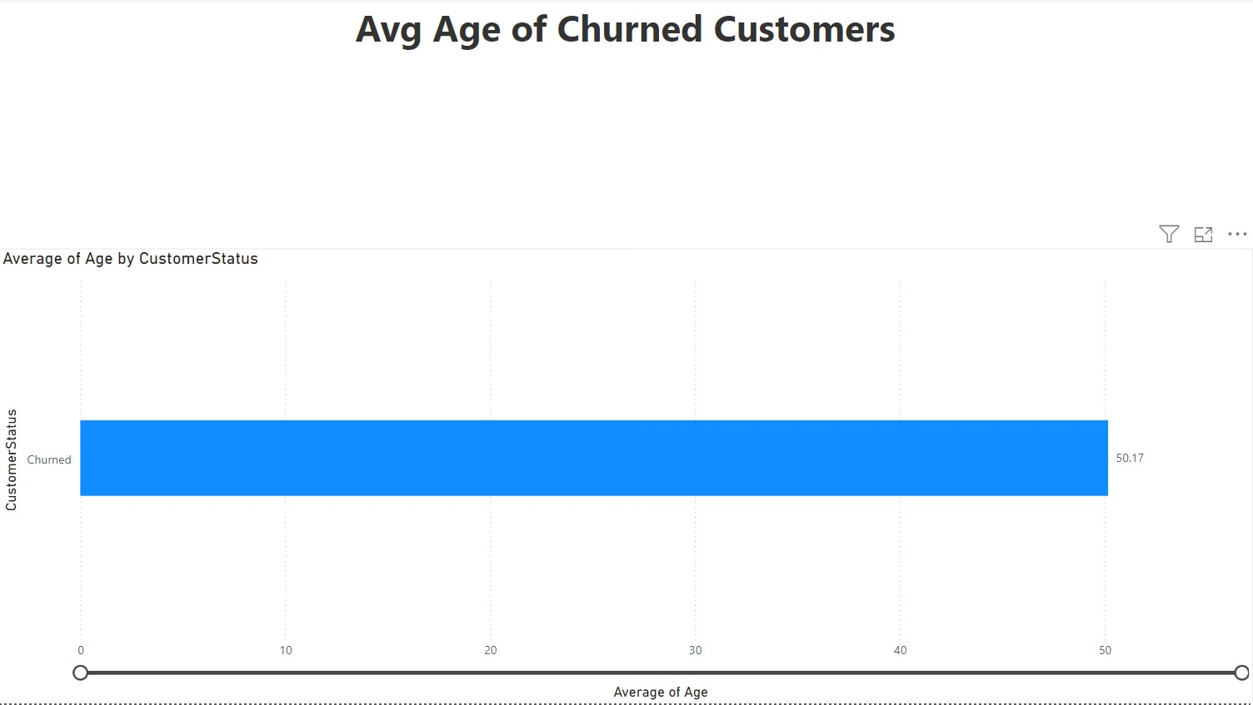
From this chart is helps to identify the average age of churned customer in the total customers
of the telecom industry
Customers are categories to Stayed, Churned, Joined.

Slide 4
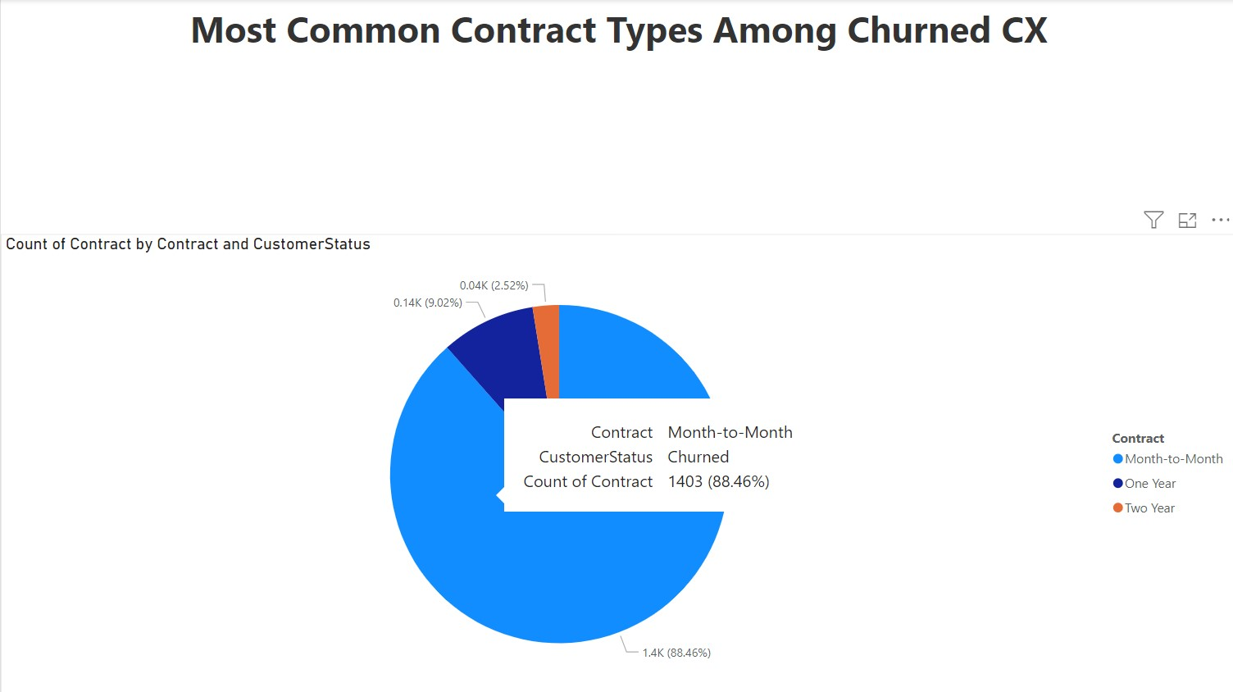
This Chart is clearly explained the contract type and customer status and count of
customer in each contract type.

Slide 5
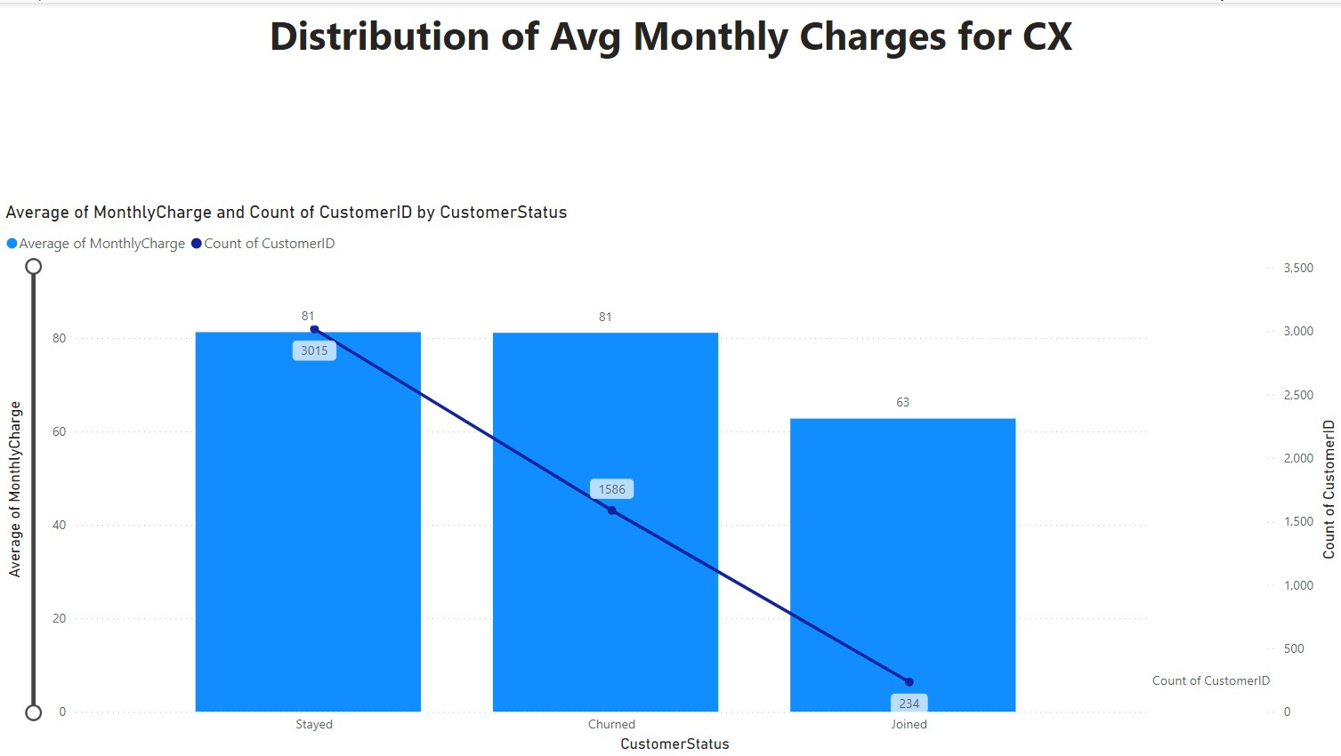
This chart represents the customer status and how much they paid for the monthly charges averagely
With the count of customer.

Slide 6
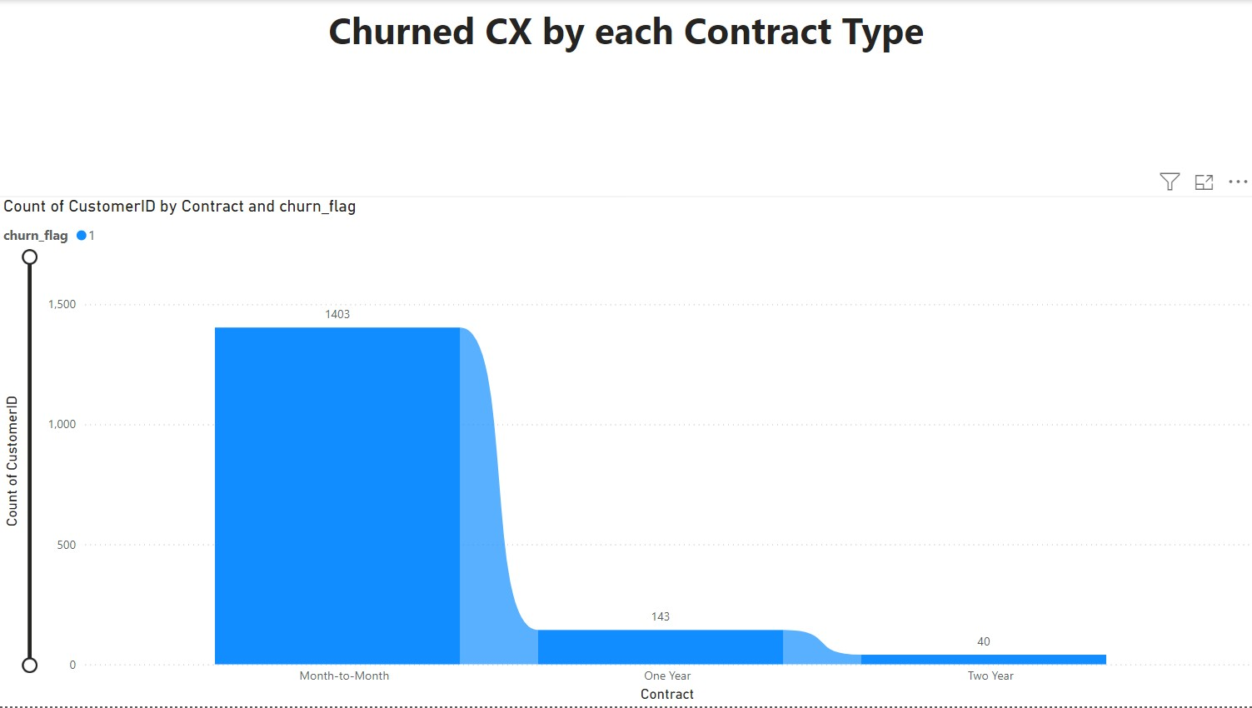
This chart is explain the type of contract with the customer count for identify the which
Contract type is having more churned customer.

Slide 7
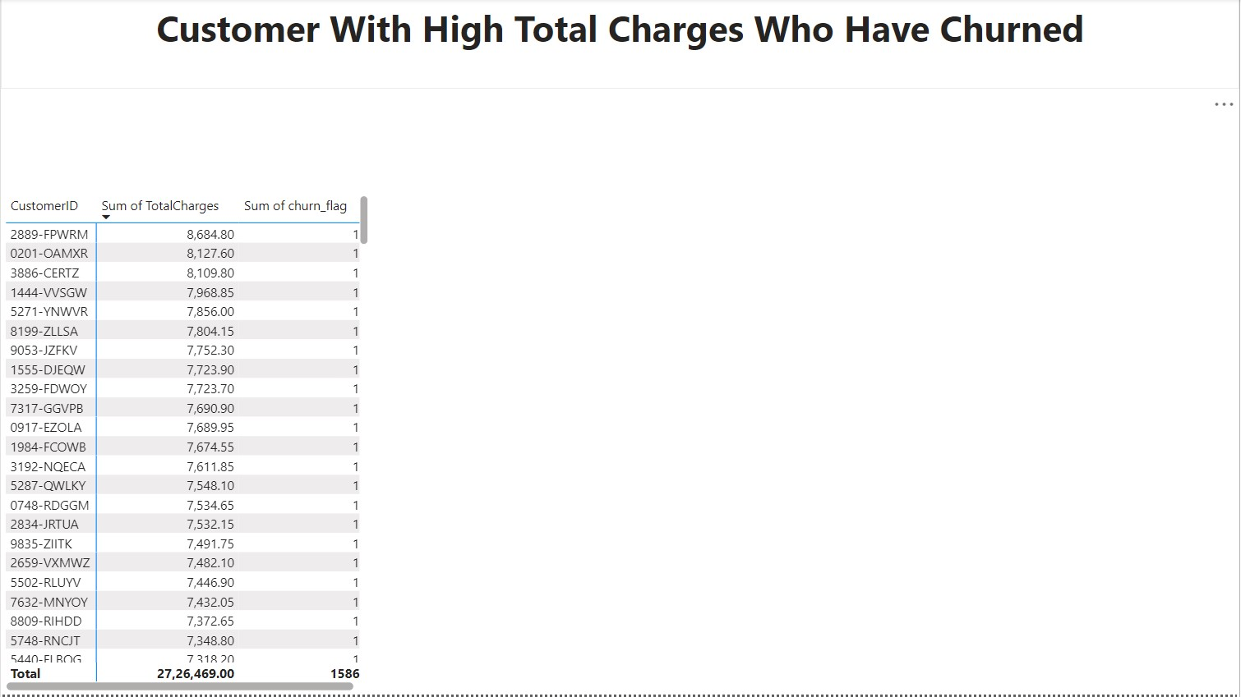
By using this chart to determine who paid high total charges in the churned customer list

Slide 8
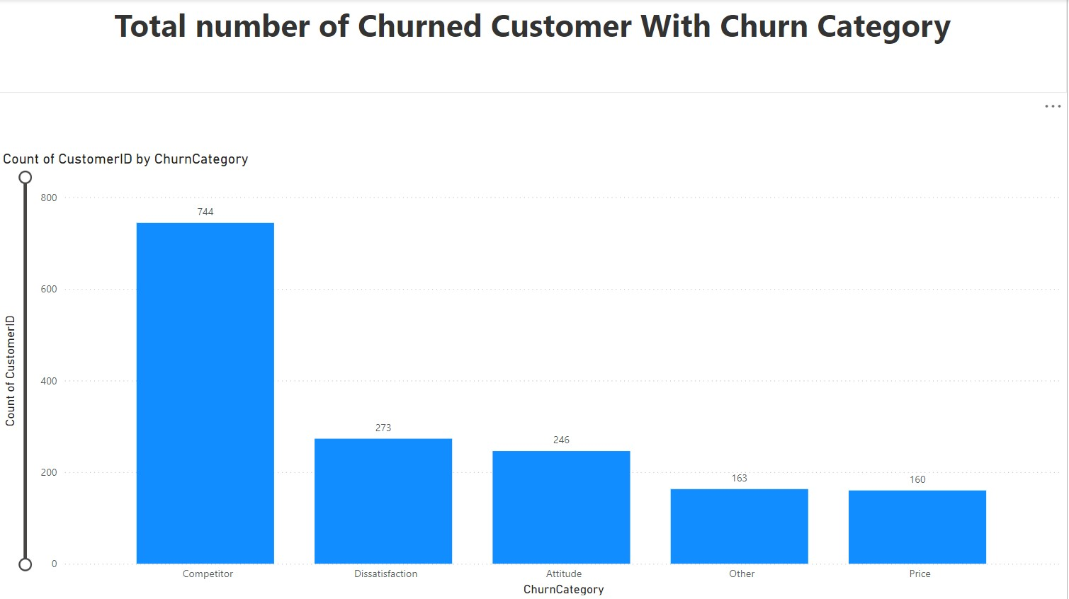
In this chart explain the Churn’s category and the count of each category with the customer ID

Slide 9
Recommendations
For Customer Retention:
Develop targeted retention strategies based on identified risk factors. For example, if monthly charges are a significant factor, consider offering discounts or promotions.
For Marketing Campaigns:
Tailor campaigns to customers with high churn probabilities. Use insights from churn patterns to craft personalized marketing messages.
For Service Improvement:
Analyze churn patterns to identify service areas needing enhancement. For instance, if churn is higher among customers with poor service usage, consider improving service quality.
For Revenue Optimization:
Focus on reducing churn by implementing proactive measures. Regularly review churn metrics and adjust strategies accordingly.
For Customer Segmentation:
Segment customers based on churn probability to offer personalized experiences and improve satisfaction.

Slide 10
Thank you

